Slide 1
Introduction To Java

Slide 2
Agenda
Java Overview
Program Construction
Discussion

Slide 3
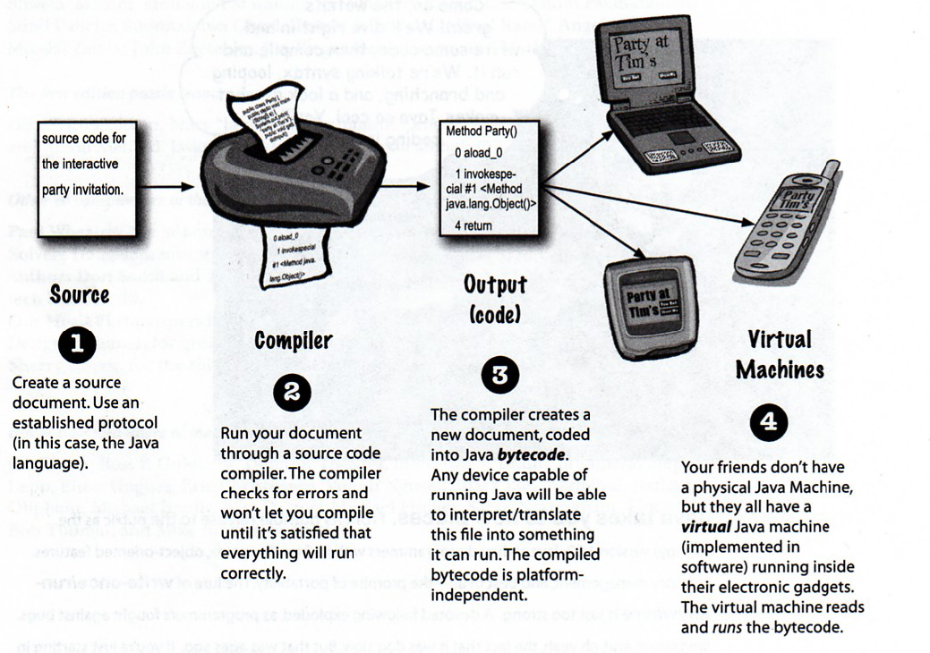
The way Java Works

Slide 4
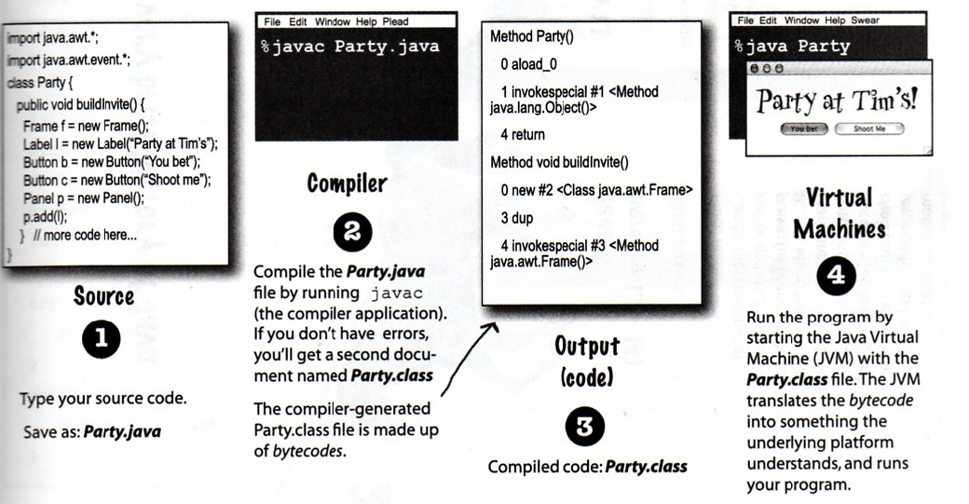
What you do with Java

Slide 5
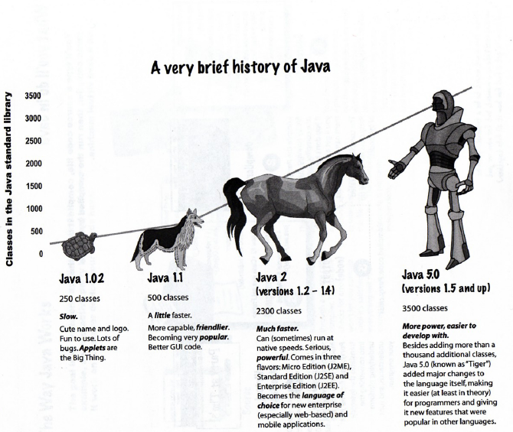

Slide 6
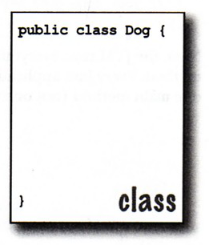
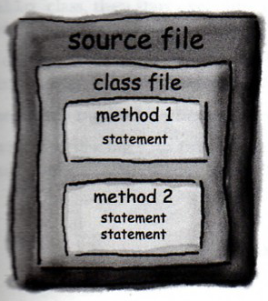
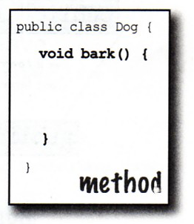
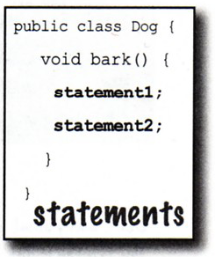
Code Structure

Slide 7
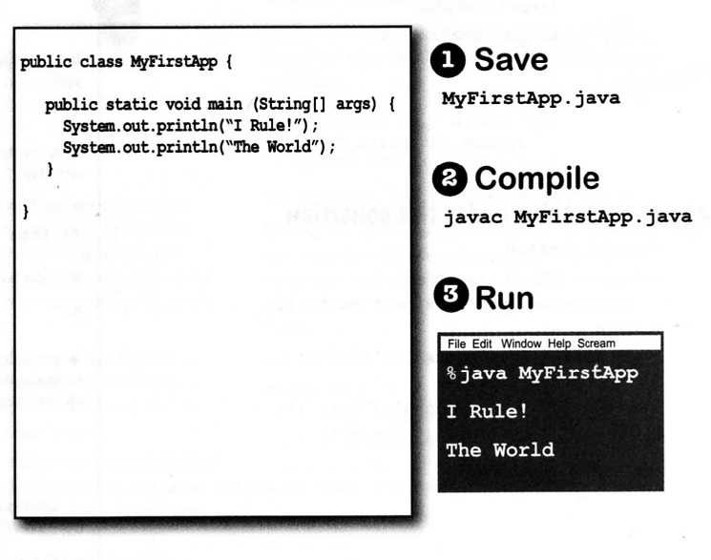
Always main….

Slide 8
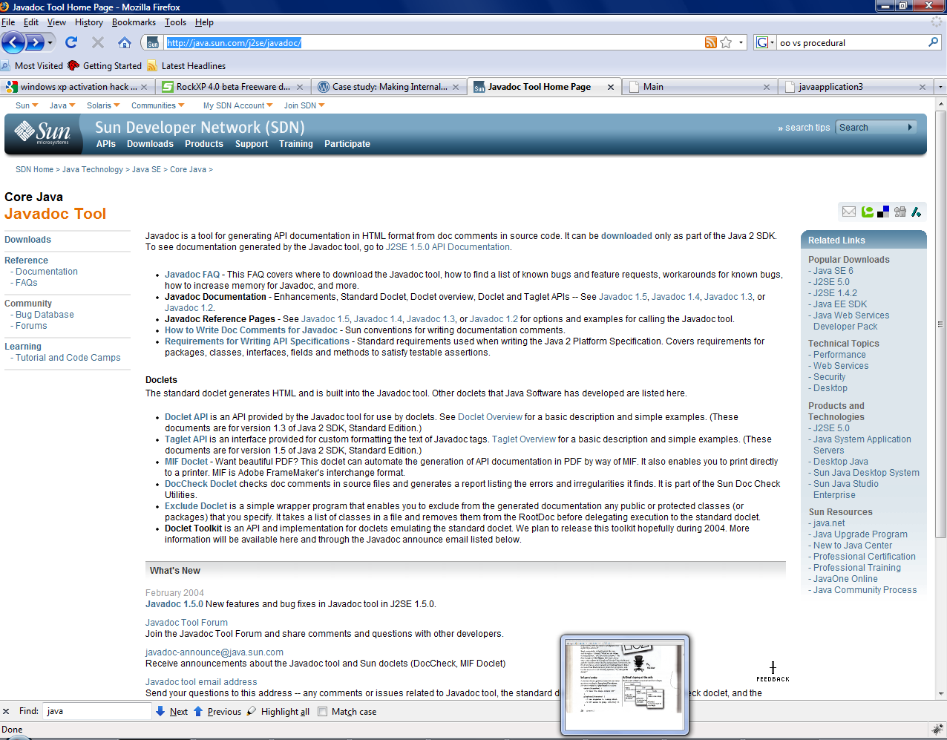
Comment as your language
Put comment on every step of your code if it necessary.
Java provide tools such us java doc to create class documentation.
See http://java.sun.com/j2se/javadoc/

Slide 9
Javadoc Example
/*
* Ini adalah program yang dibuat untuk menjelaskan fungsi
* Javadoc.
* Selalu simpan komentar pada setiap baris ya..
*/
package javaapplication3;
/**
*Deskripsikan class secara detail.
* @author panji
* @since 03 March 2009
* @version 1.0
*/
public class Main {
/**
* Ini adalah fungsi main aplikasi
* @param args sebagai input
*/
public static void main(String[] args) {
// TODO code application logic here
}
/**
* Fungsi ini adalah contoh penggunaan
* java doc
* @param a ini contoh input a
* @param b ini contoh input b
* @return Mengembalikan nilai a+b
*/
public int contohFungsi(int a,int b){
return (a+b);
}
}
Result

Slide 10
Change your way, about how you see the solutions
…its OO geek says..

Slide 11
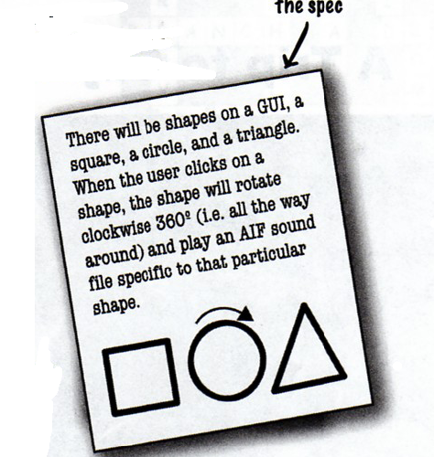
Jump Start Quizz

Slide 12



Whose will fight?
Procedural Geek
OO Geek

Slide 13
Procedural Geek
Function1
Other Function2
Other function 3
Function 2
Other Function
Rotate
Sound

Slide 14
OO Geek
Object 1
Properti
Method
Object 2
Properti
Object 3
Properti
Method
Method

Slide 15
What Next to Learn?
Object Construction
Logical statement
Iteration
Polymorphism
Inheritance
You already get all this stuff in basprog..☺

Slide 16
How about Editor?
Notepad
Notepad++
NetBean
Eclipse

Slide 17
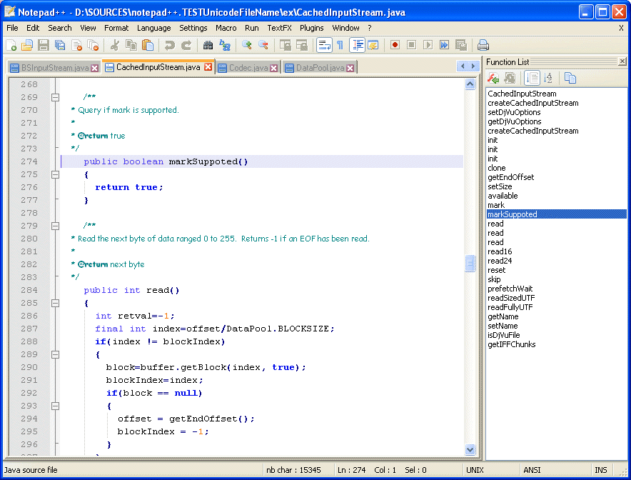
Notepad++

Slide 18
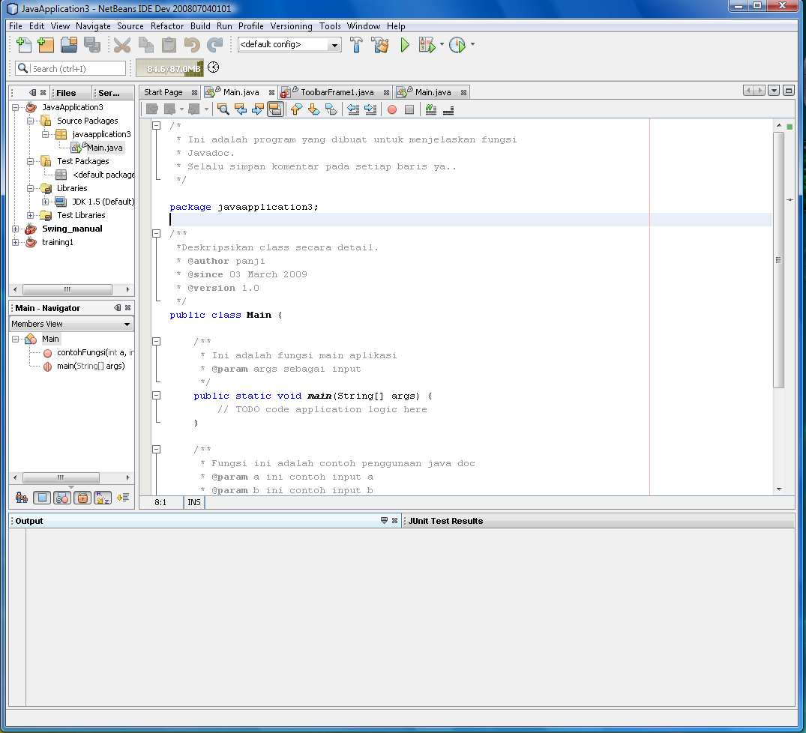
NetBean

Slide 19
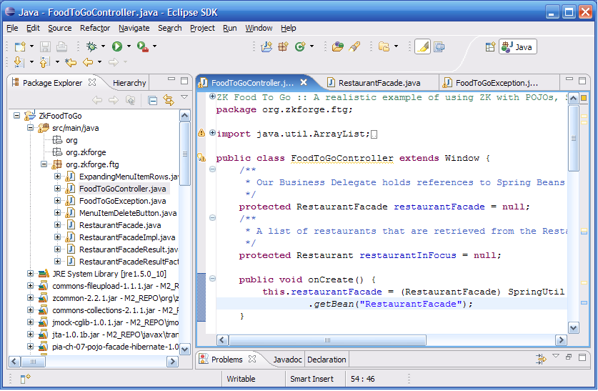
Eclipse

Slide 20
Any Question?

